Slide 1
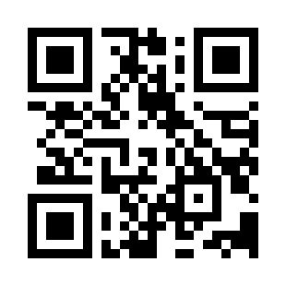

Software Project Initiation
https://bit.ly/3gqFXqb

